Slide 1
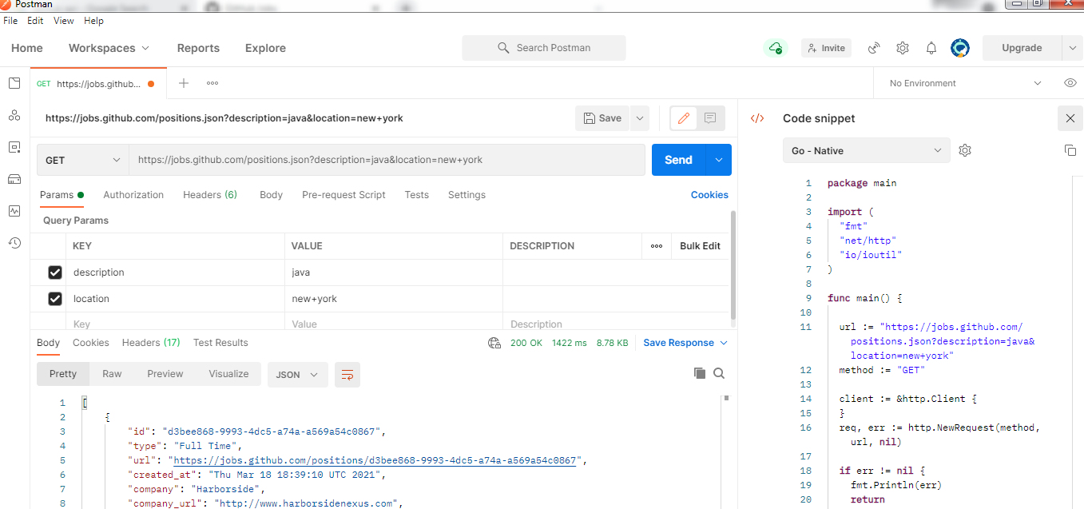
Postman – Code Snippet

